Slide 1

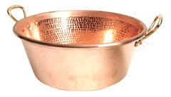
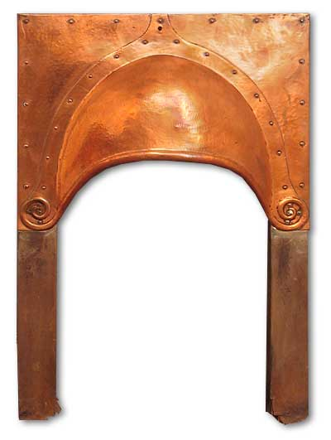
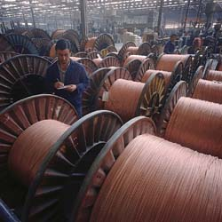
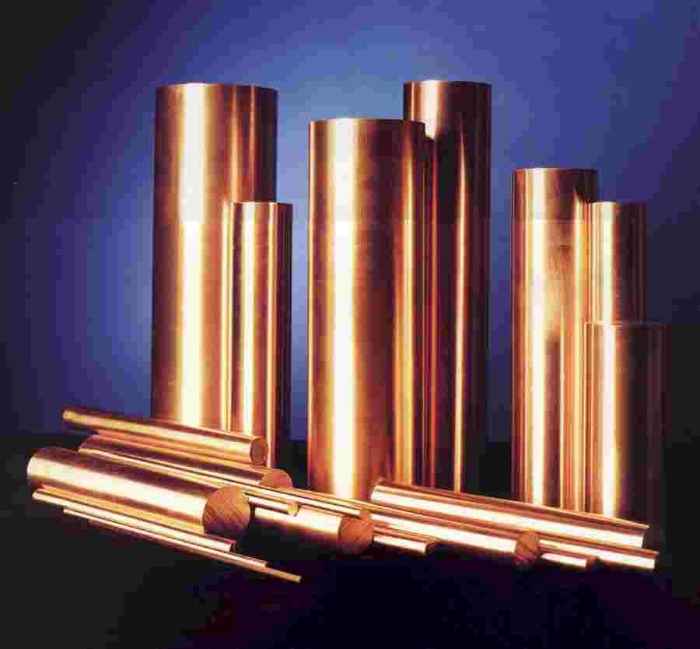

6.4 Purifying Copper
How many uses can you name for copper?

Slide 2
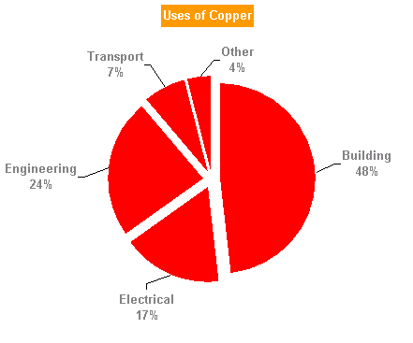
6.4 Purifying Copper
Copper needs to be purified.
Electrolysis is used to purify copper.
Europe consumes around 10kg of copper per person per year. 1kg of Copper is worth around £8.50.

Slide 3
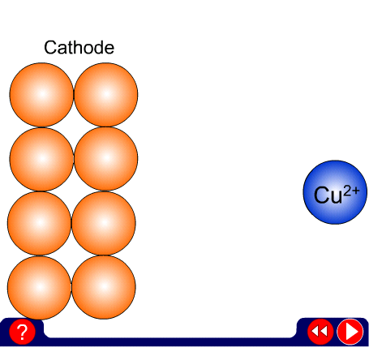
Refining Copper
Electrons attracted
positive negative
Cathodes have a ____________ charge. Copper ions have a __________ charge. The Copper ion is _________ to the cathode where it gains __________ and becomes a copper atom.

Slide 4
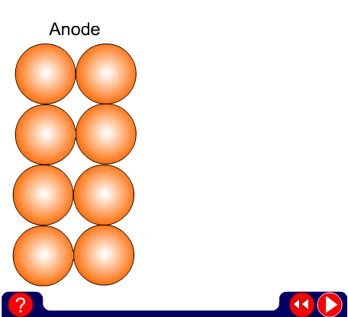
Electrons repelled
positive negative
Anodes have a ____________ charge. The copper atom is _________ from the anode where it lost __________ and became a copper ion.

Slide 5
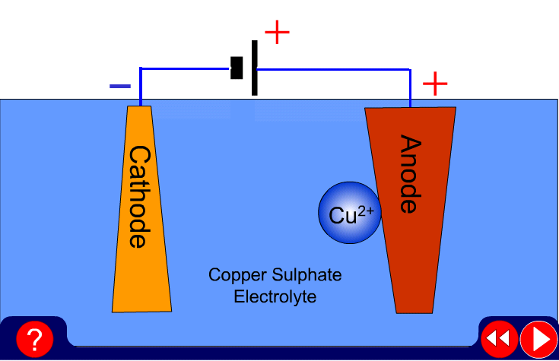
The whole process

Slide 6


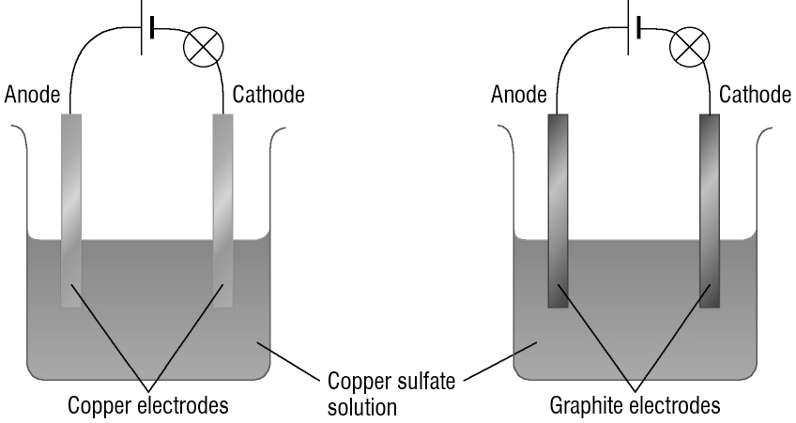
Comparing electrodes
Method
Diagram
Half-fill each beaker with copper sulfate solution (HARMFUL)
Connect the power supplies to the electrodes as shown.
Compare the copper and graphite electrodes and record in the table.
Observations
Copper | Graphite

Slide 7
Questions
Which electrode does the copper collect on?
What is a flow of charged particles called?
How could you speed up this process?
How could you measure this better?
What environmental problems might be caused using this process? (Electricity use and waste materials)

Slide 8
6.4 Purifying Copper
Copper extracted from its ore contains impurities such as gold and silver.
Copper is purified using electrolysis to remove these substances.

